Slide 1
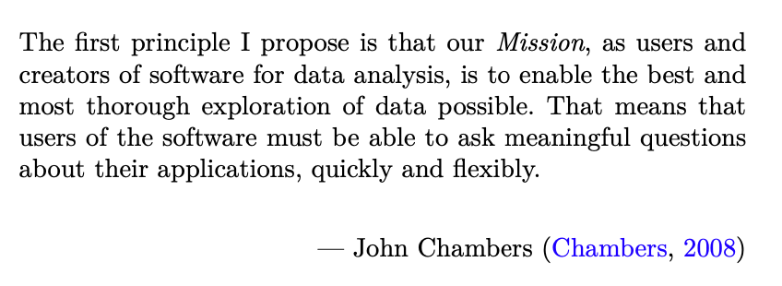

Exploring Operations Research with R: MAI Workshop OR66
https://github.com/JimDuggan/Exploring-OR-with-R-Workshop

Slide 2




Instructor –Jim Duggan
Lectures in
Programming (R, MATLAB, Python),
Modelling & Simulation
Research interests:
System Dynamics
Public Health
Data Science
https://education.rstudio.com/trainers/people/duggan+jim/

Slide 3
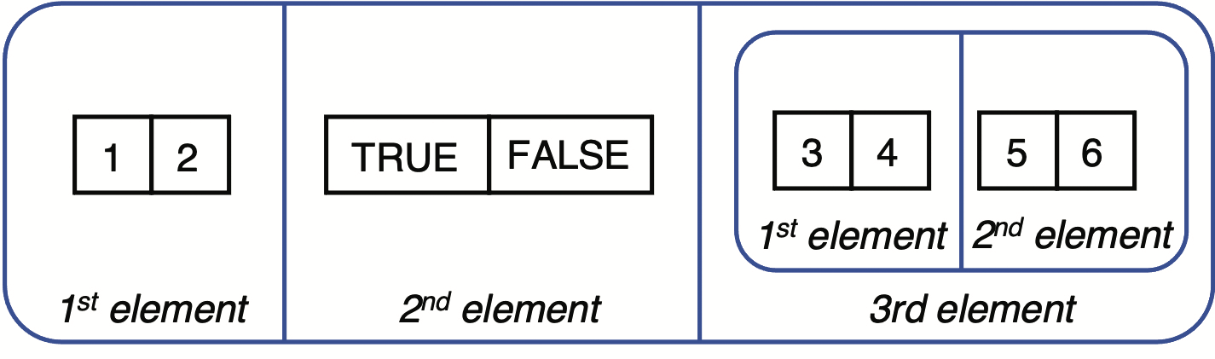
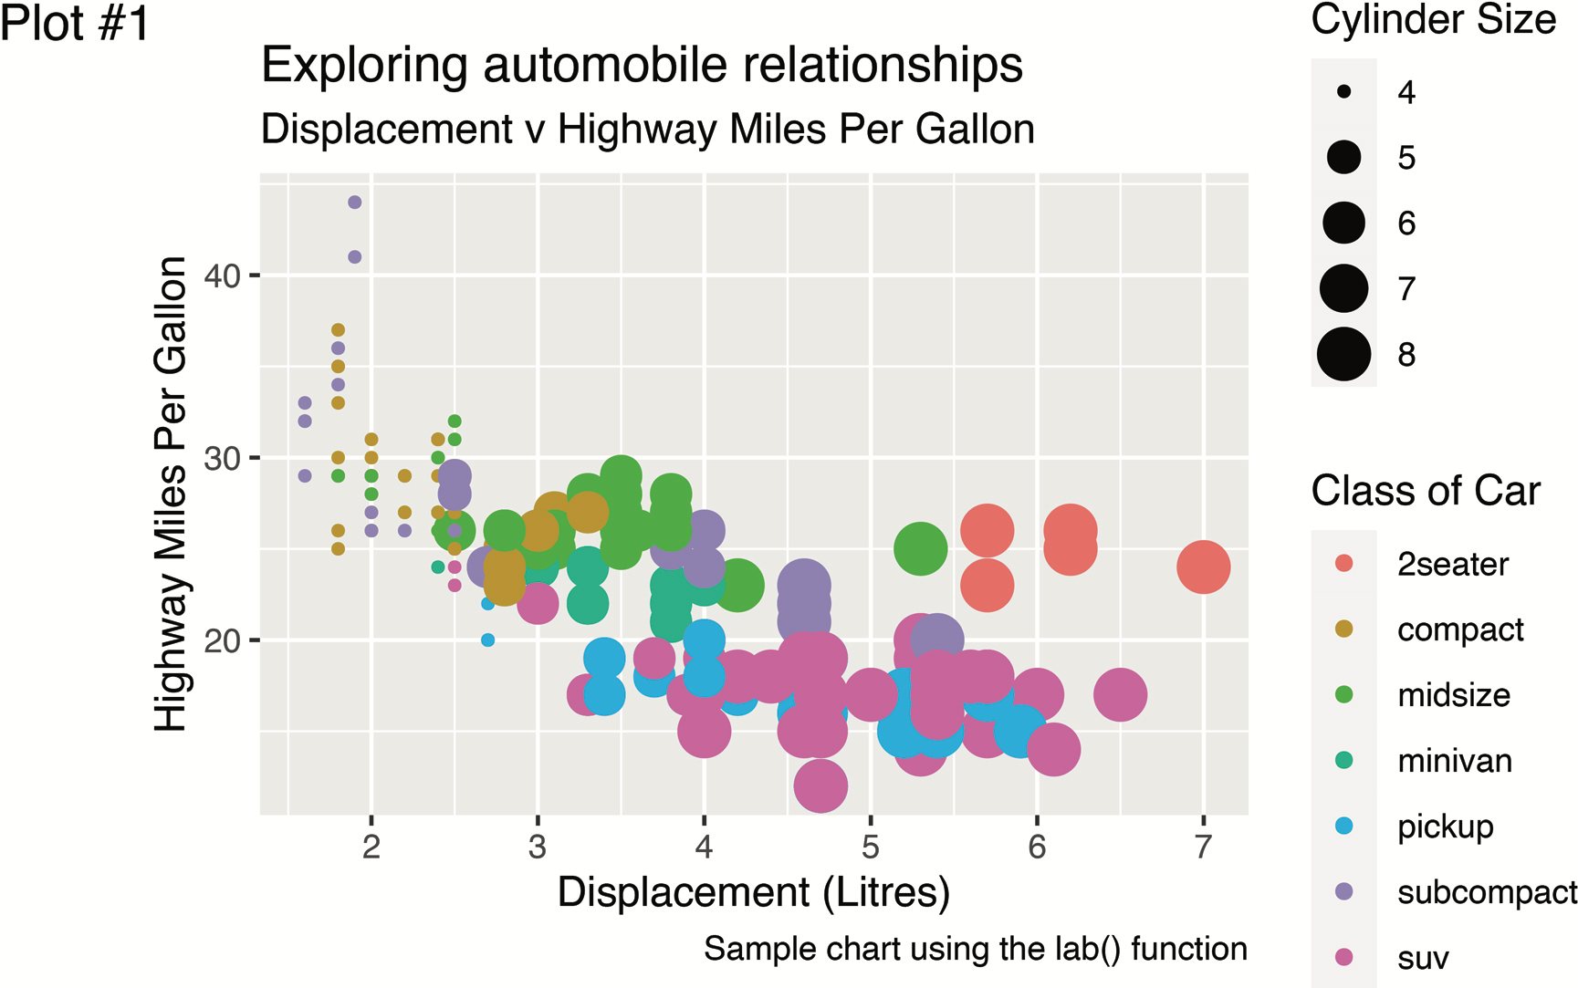
Goal
Show how the R programming language can be a valuable tool – and way of thinking – which can be successfully applied to the field of operations research (OR).
Core R tools (tidyverse)
Application areas to OR:
Exploratory Data Analysis
Linear Programming
Agent-Based Simulation
System Dynamics

Slide 4
Topics Overview
Topic | Description | ~Timing
1 | Introduction to R and Posit Cloud | 10 mins
2 | Storing data using data frames / tibbles | 10 mins
3 | Visualisation with ggplot2 | 20 mins
4 | Data transformation with dplyr | 20 mins
5 | Using R with OR – Four Examples | 30 mins

Slide 5

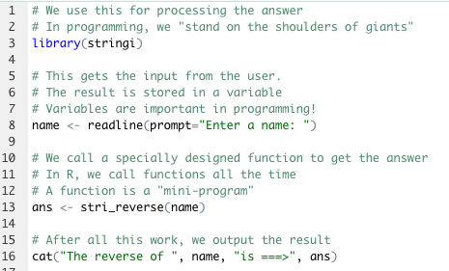
The R Project for Statistical Computing
R’s mission is to enable the best and most thorough exploration of data possible (Chambers 2008).
It is a dialect of the S language, developed at Bell Laboratories
ACM noted that S “will forever alter the way people analyze, visualize, and manipulate data”

Slide 6
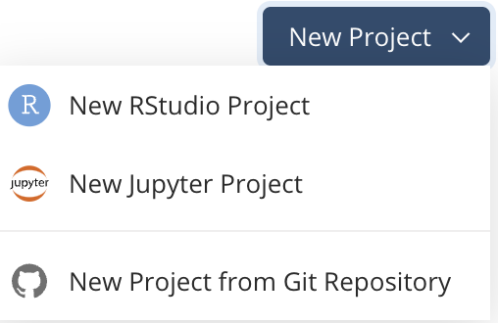
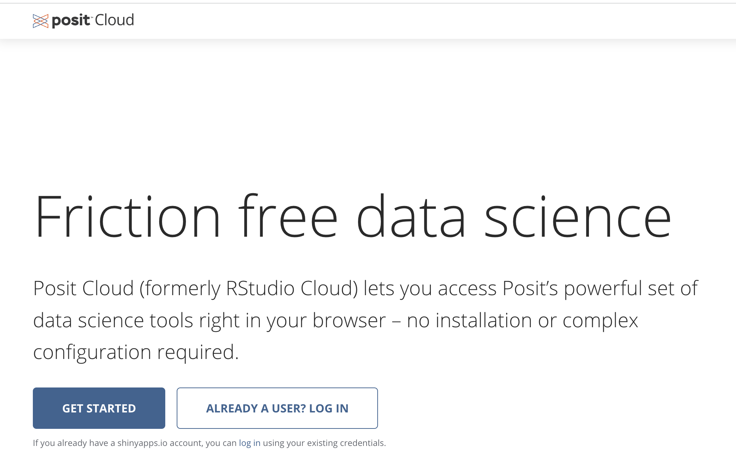
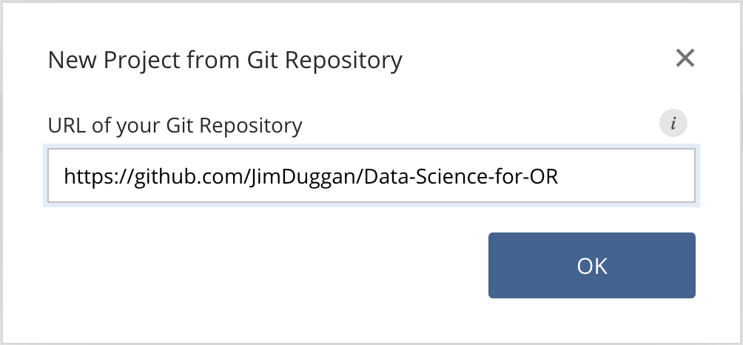
First Steps: Posit Cloud – Create Your Account

Slide 7
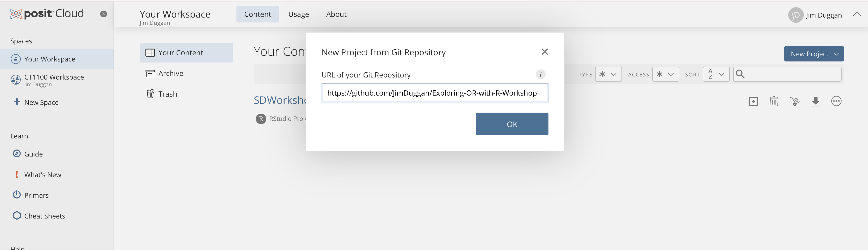
Install the codebase from github…

Slide 8
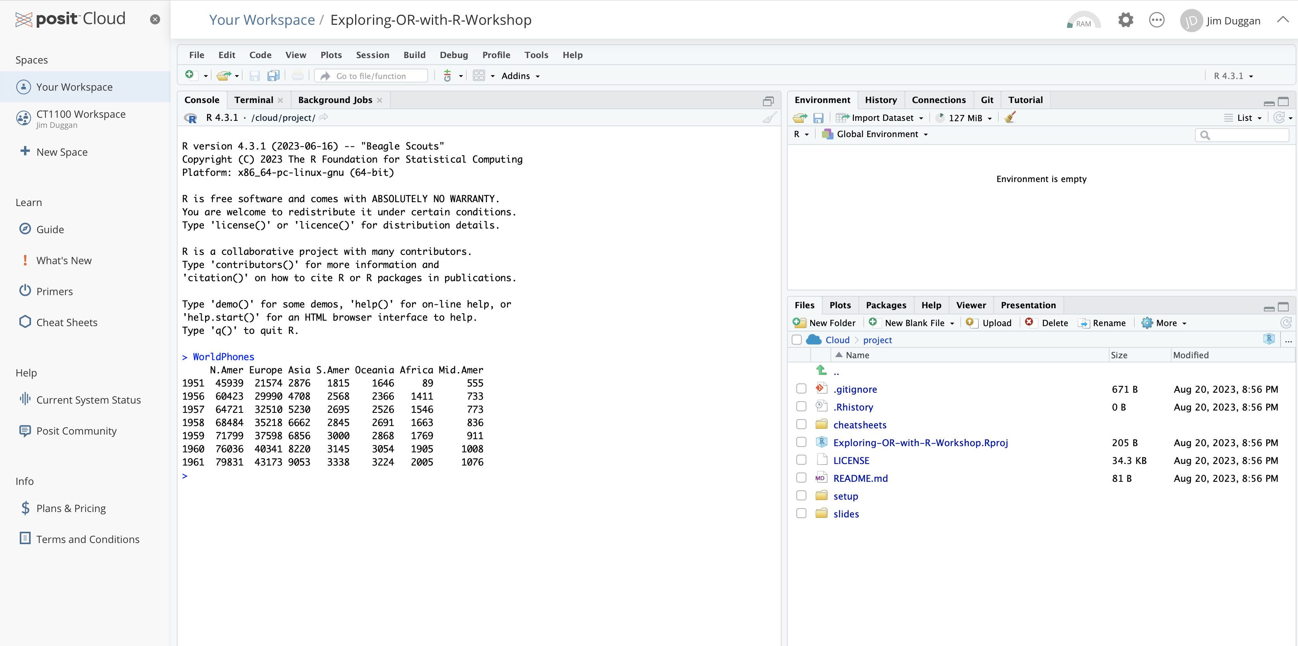
IDE Available for running scripts

Slide 9
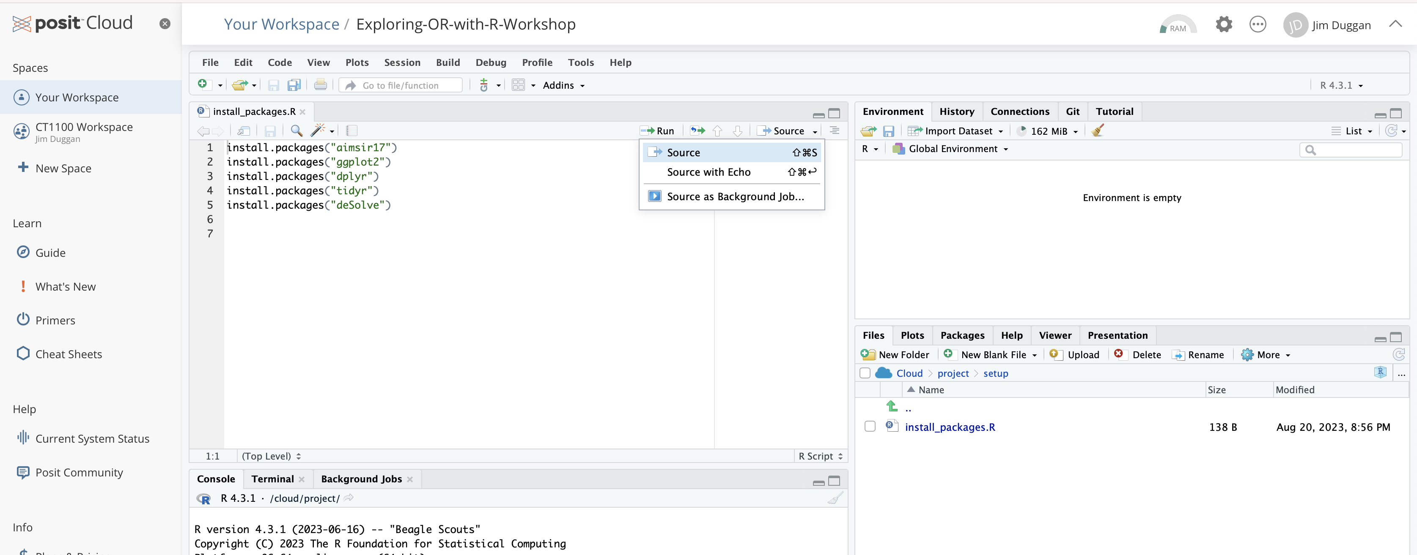
Run setup file…

Slide 10
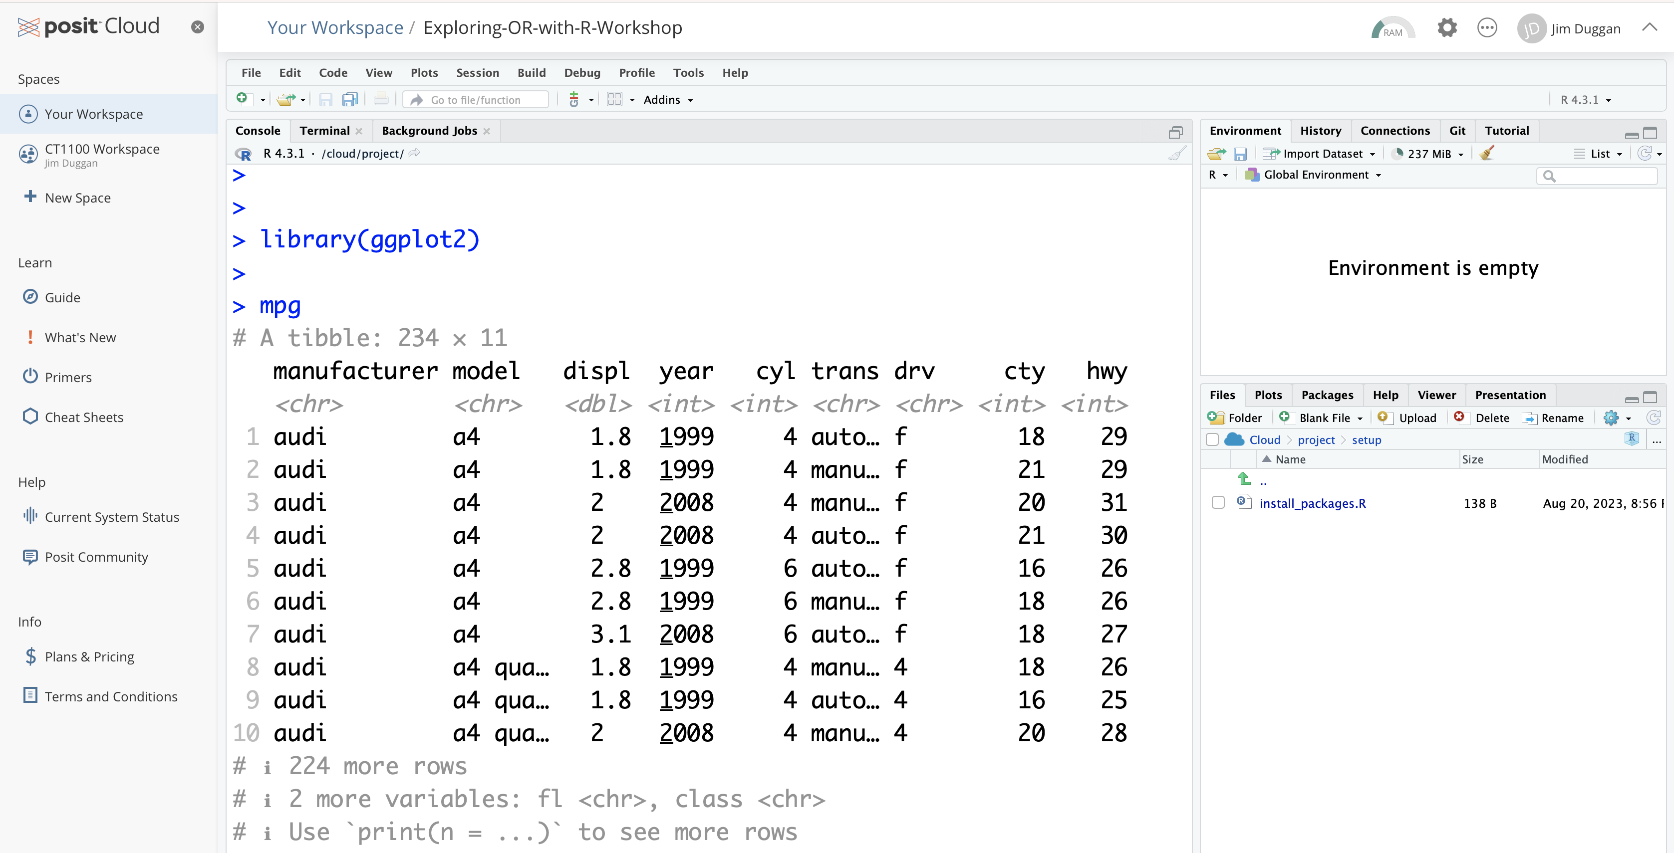
A quick check… the ggplot2 mpg dataset

Slide 11
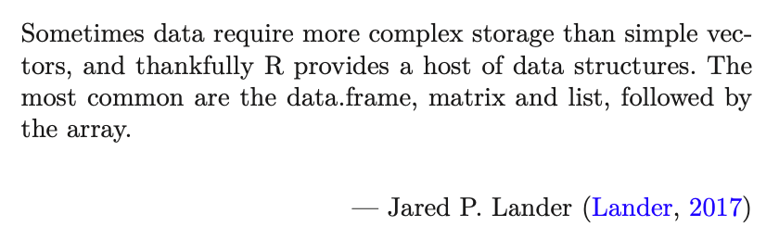
02 – Data storage with the data frame/tibble
https://github.com/JimDuggan/Exploring-OR-with-R-Workshop

Slide 12
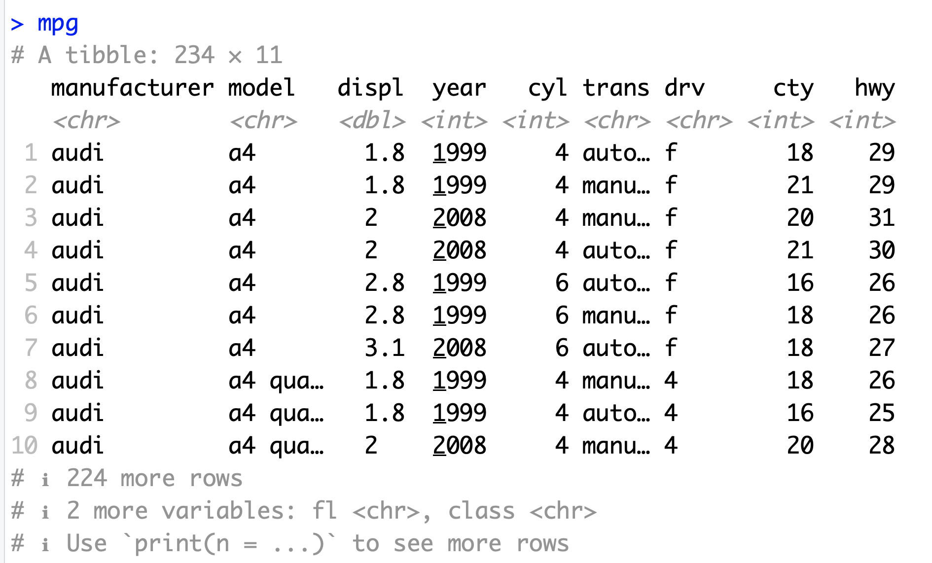
Data Frames/Tibbles
The most common way of storing data in R
A two-dimensional structure, with rows (observations) and columns (variables)

Slide 13
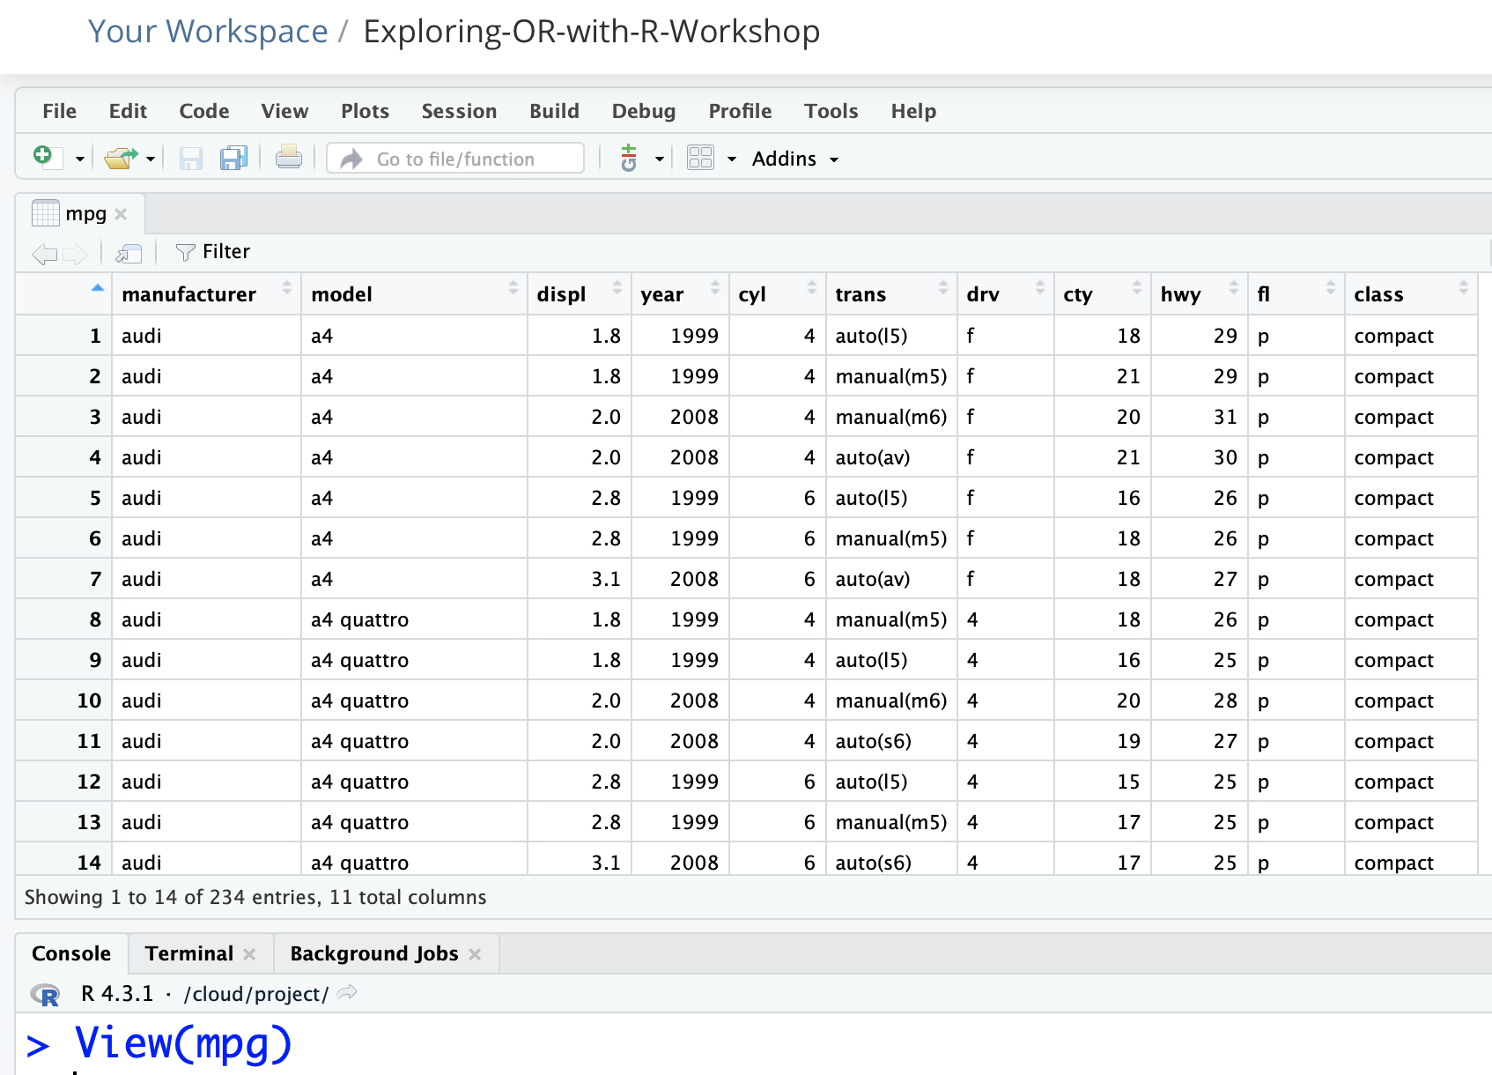
In the computer’s memory, just like a spreadsheet

Slide 14
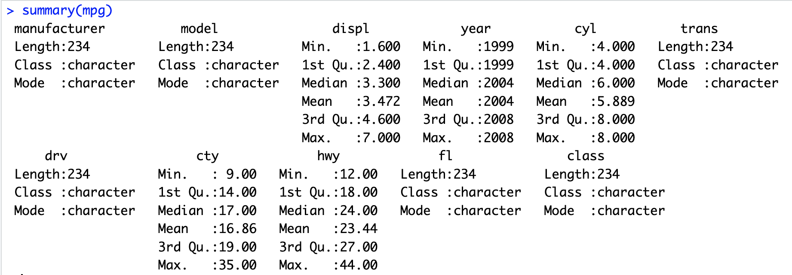
The summary() function

Slide 15
Challenge 2.1
Explore some of the following tibbles in R
mpg (ggplot2)
diamonds (ggplot2)
observations (aimsir17)
eirgrid17 (aimsir17)
stations (aimsir17)

Slide 16
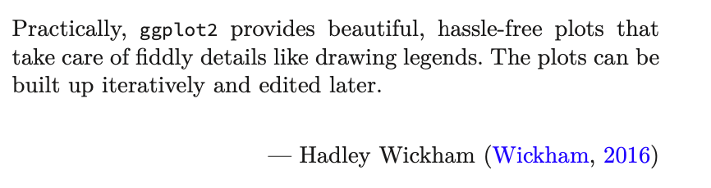
03 – Visualisation with ggplot2
https://github.com/JimDuggan/Exploring-OR-with-R-Workshop

Slide 17
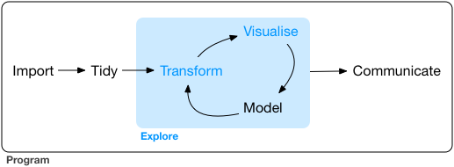
Data Exploration
“Data exploration is the art of looking at your data, rapidly generating hypotheses, quickly testing them, then repeating again and again and again.” (Wickham and Grolemund 2017).

Slide 18
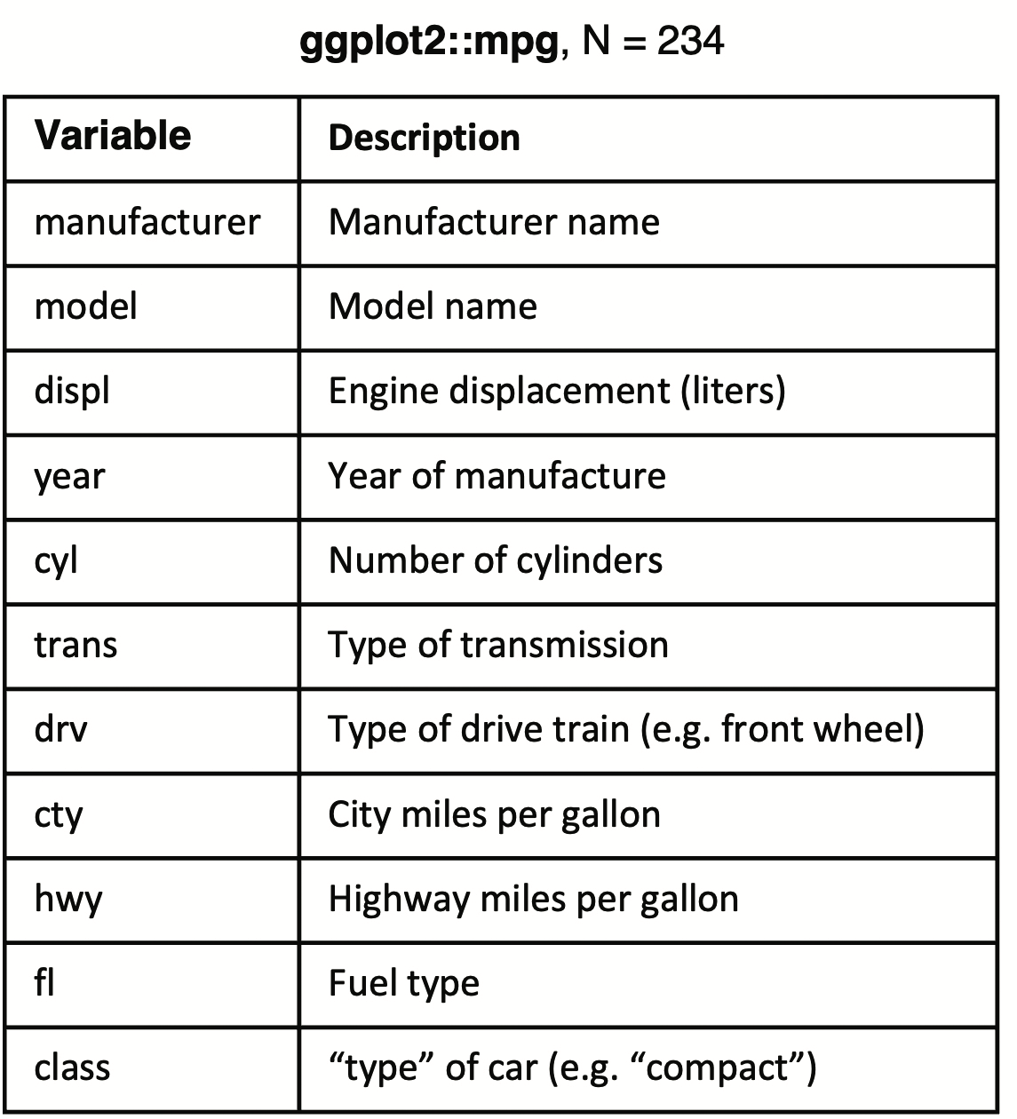
ggplot2
Layered grammar of graphics, enables us to concisely describe the components of a graphic.
Benefits:
plots can be designed in a layered manner (+ operator)
a wide range of plots can be generated to support decision analysis, including scatterplots, histograms and time series charts
charts can be developed rapidly, and this support an iterative process of decision support

Slide 19
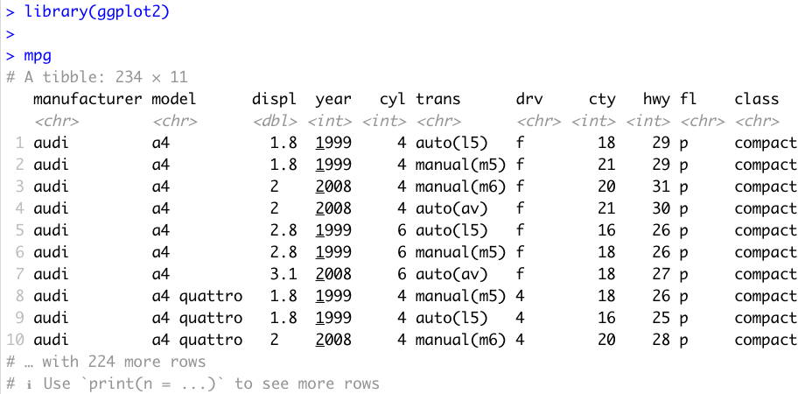
Data Visualisation with ggplot2
“The simple graph has brought more information to the data analyst’s mind that any other device.” – John Tukey

Slide 20
First Steps
Generate a first graph to help answer the following question:
Do cars with big engines use more fuel than cars with small engines
What might the relationship between engine size and fuel efficiency look like?
Need to draw a scatter plot

Slide 21
Selecting data (from columns)
Among the variables are:
displ, a car’s engine size in litres
hwy, a car’s fuel efficiency on the highway in miles per gallon

Slide 22
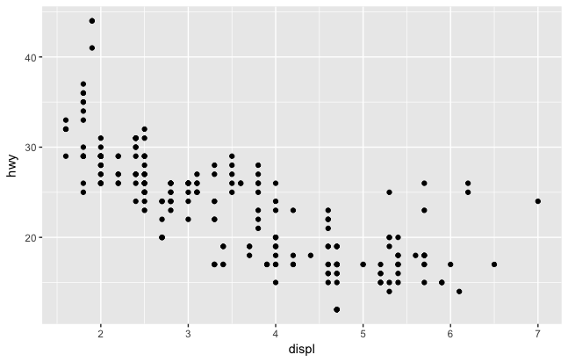
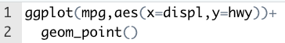
Creating a ggplot

Slide 23
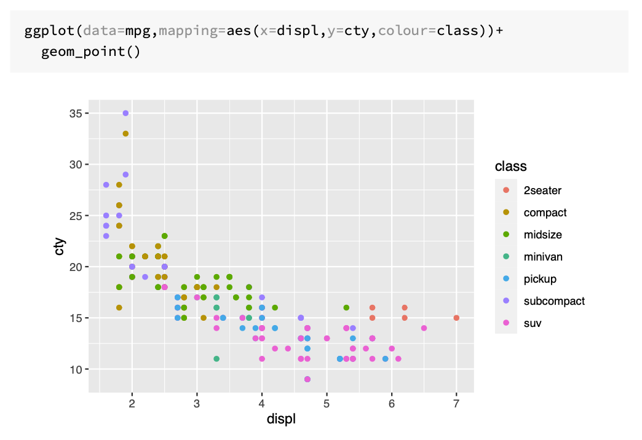

Slide 24
Customising Plot Appearance with lab()
Argument | Role
title | provides an overall title text for the plot
subtitle | adds a subtitle text
colour | allows you to specify the legend name for the colour attribute
caption | inserts text on the lower right hand side of your plot
size | allows you to name the size attribute
x | name the x-axis
y | name the y-axis
tag | text for tag label for top-left of plot

Slide 25
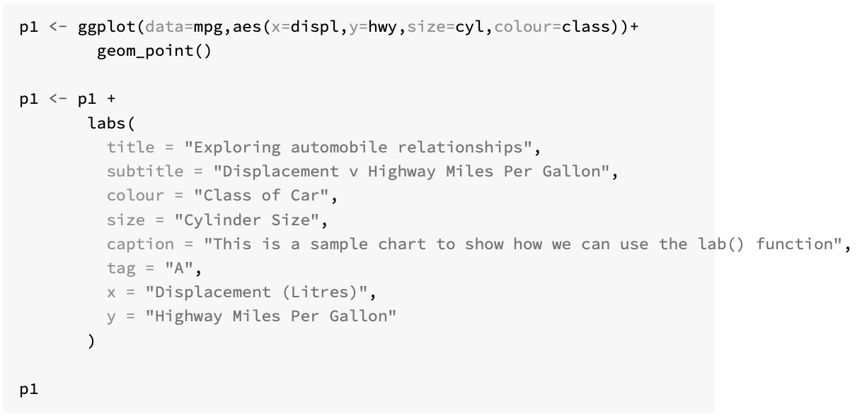

Slide 26
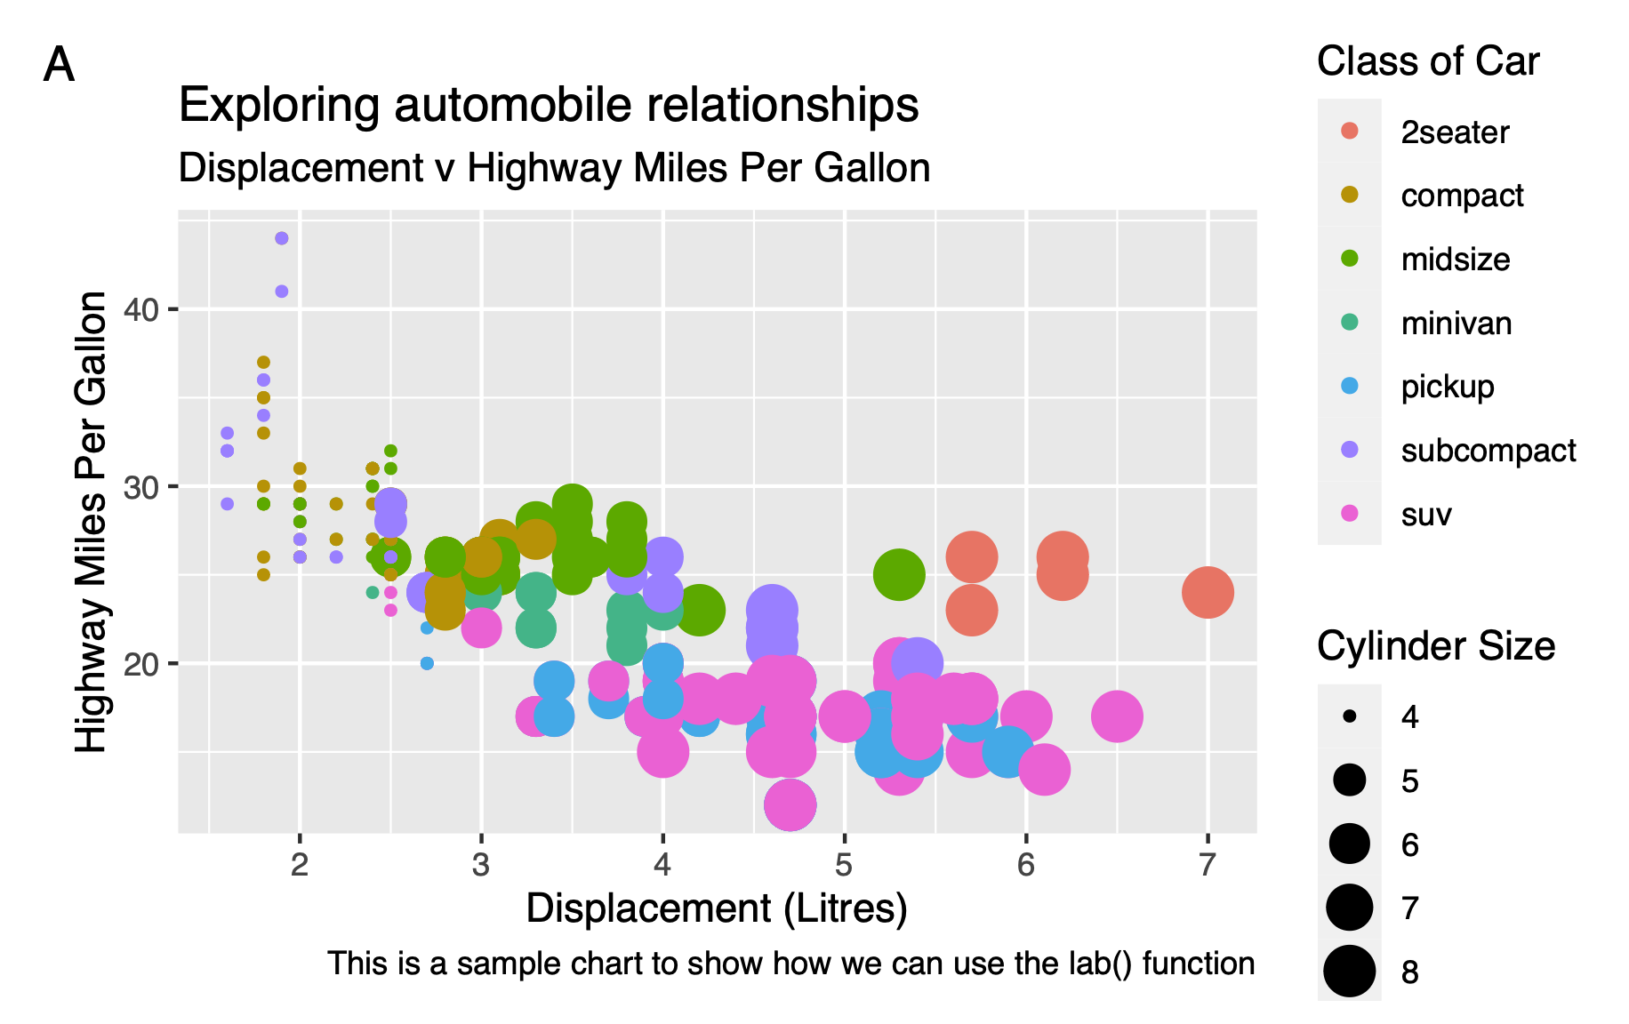

Slide 27
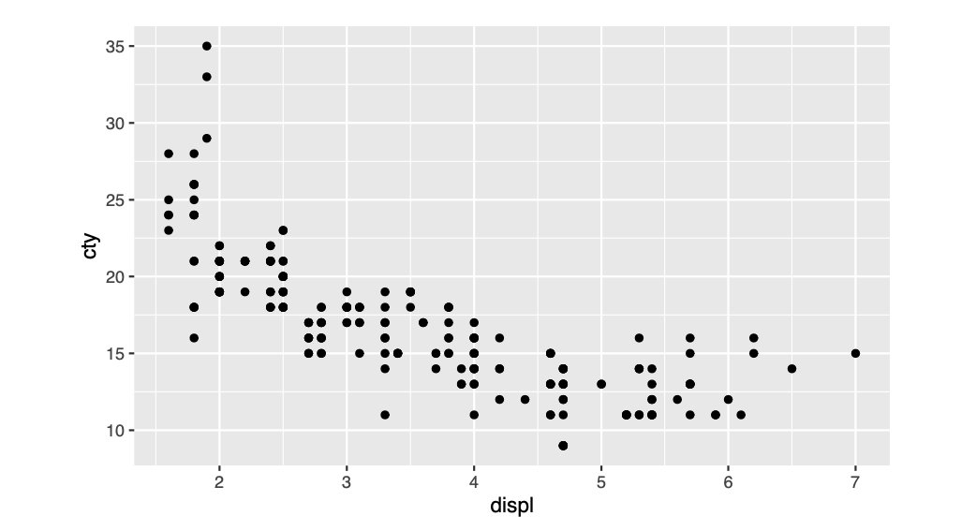
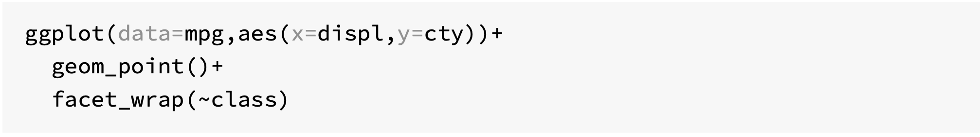
Subplots with Facets

Slide 28
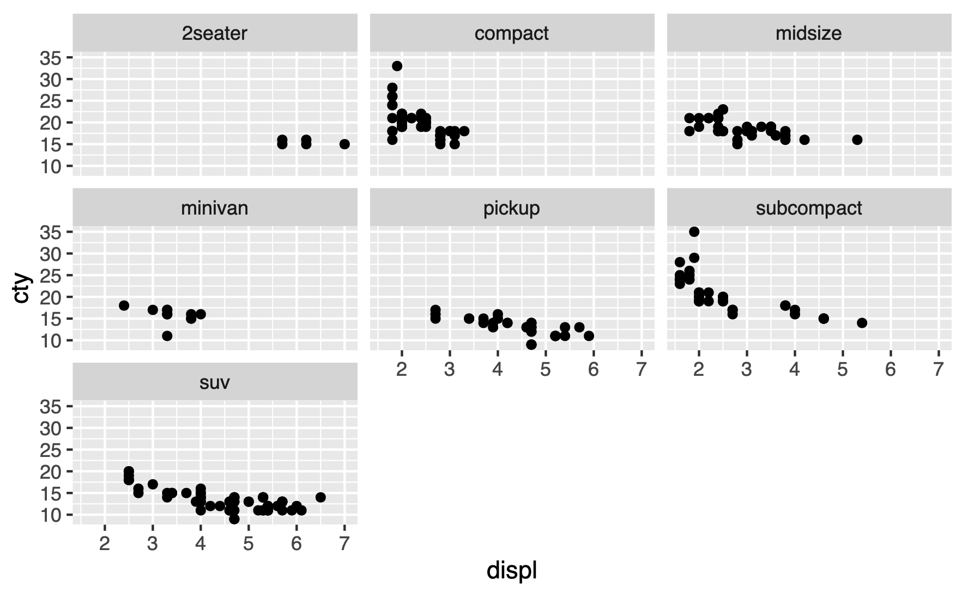

Slide 29
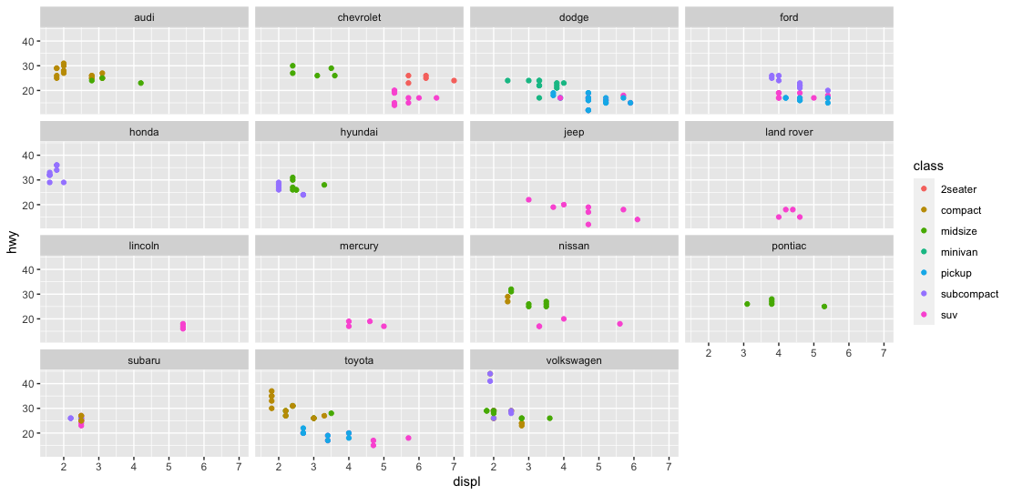
Challenge 3.1
Generate the following scatter plot (displ v hwy) from the tibble mpg (ggplot2 library)

Slide 30
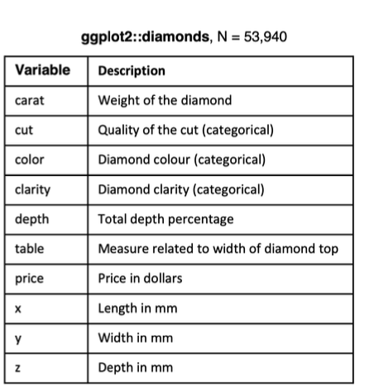
Statistical Transformations
Many graphs, like scatterplots, plot the raw values of the dataset
However, other graphs (e.g. bar charts) calculate new values to plot
Bar charts, histograms and frequency polygons bin your data and plot bin counts, the number of points that fall in each bin
Smoothers fit a model to your data and the plot predictions from the model
Boxplots compute a robust summary of the distribution and display a specially formatted box

Slide 31
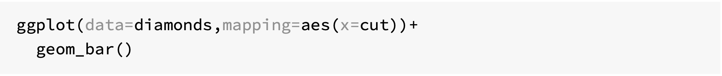
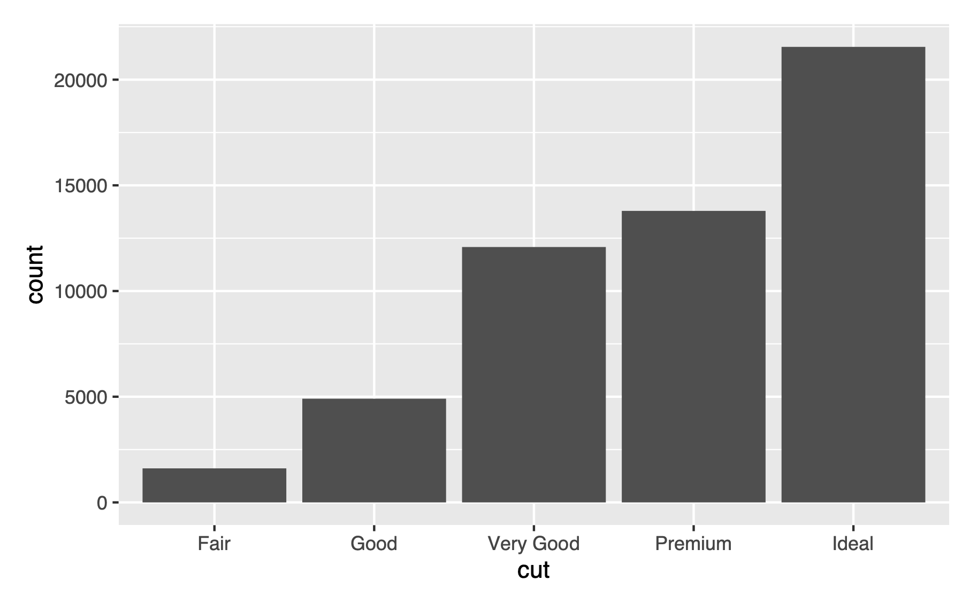

Slide 32
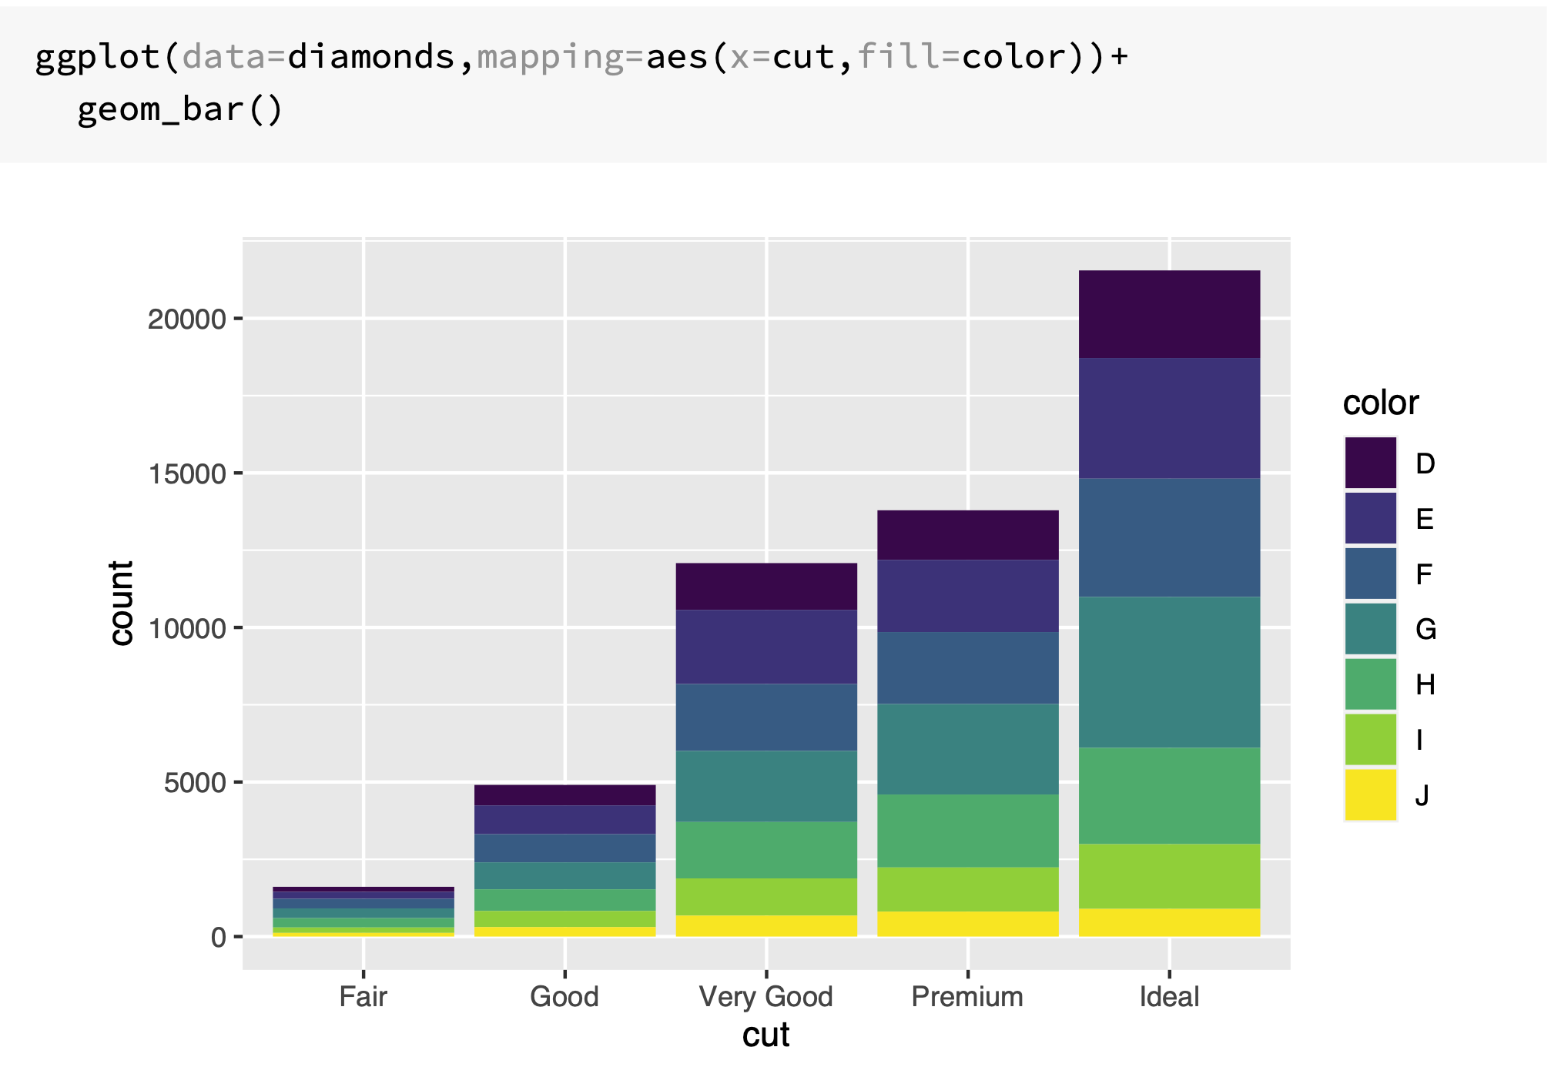

Slide 33
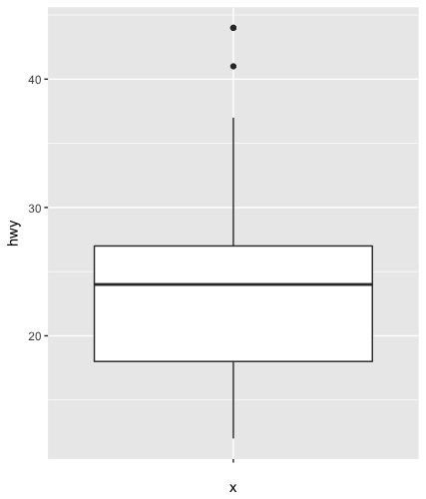
Boxplot
Display the distribution of a continuous variable broken down by a categorical variable
Box that stretches from the 25th to 75th percentile a distance known as the interquartile range (IRQ)
Median in the middle of box
Points outside more that 1.5 times the IQR from either edge of the box are displayed (outliers)
Whisker extends to the farthest non-outlier point in the distribution

Slide 34
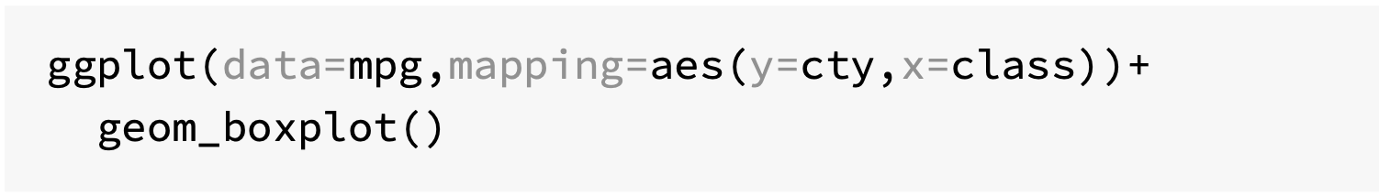
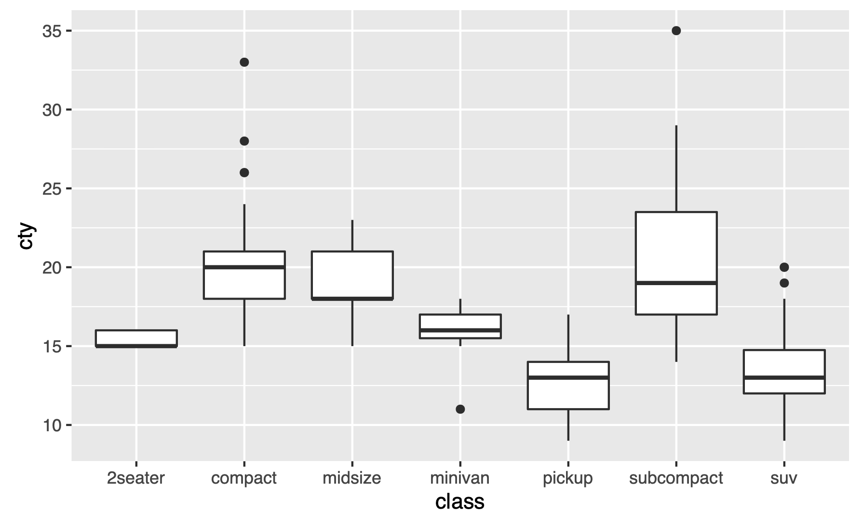

Slide 35
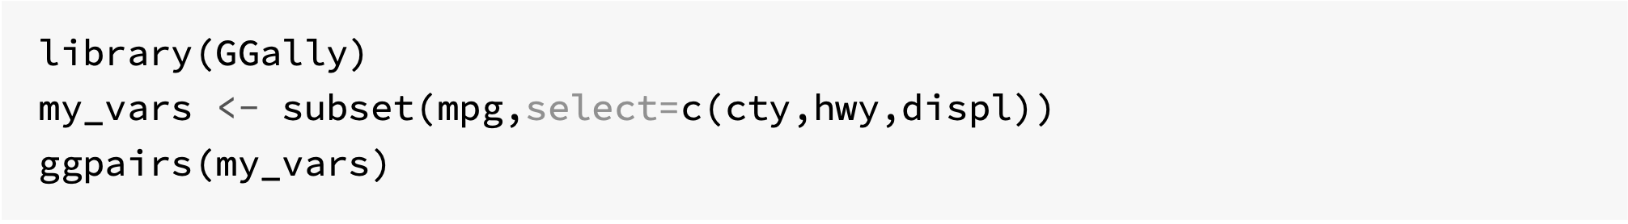
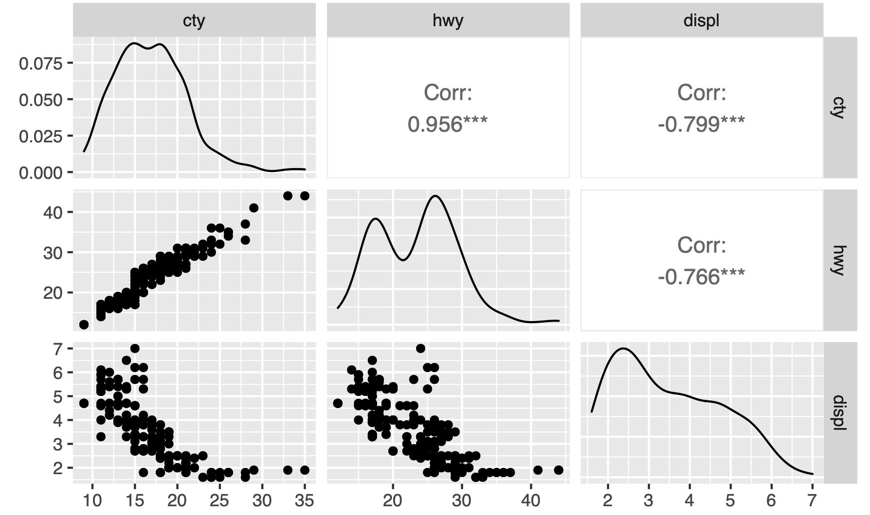
Covariation with ggpairs()

Slide 36
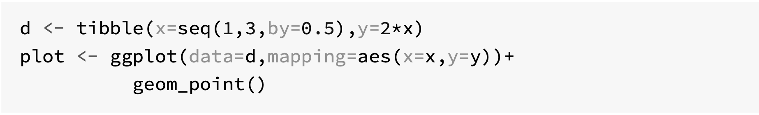
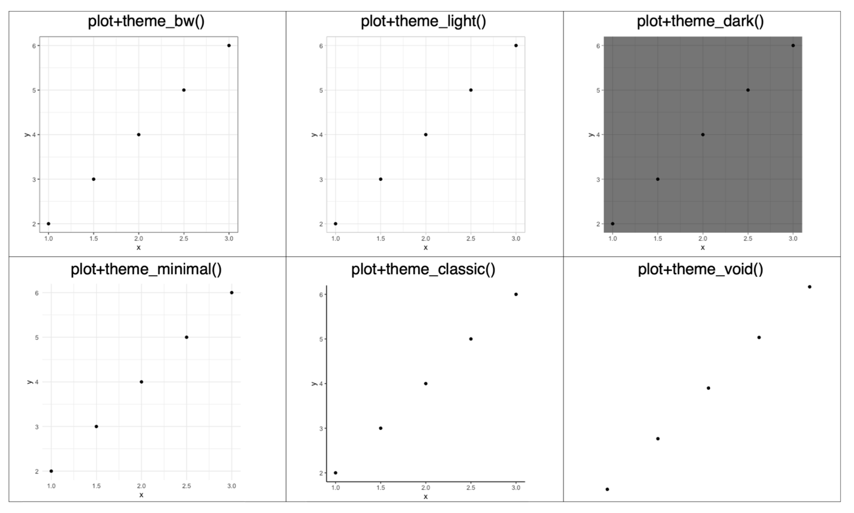
Ready to use themes

Slide 37
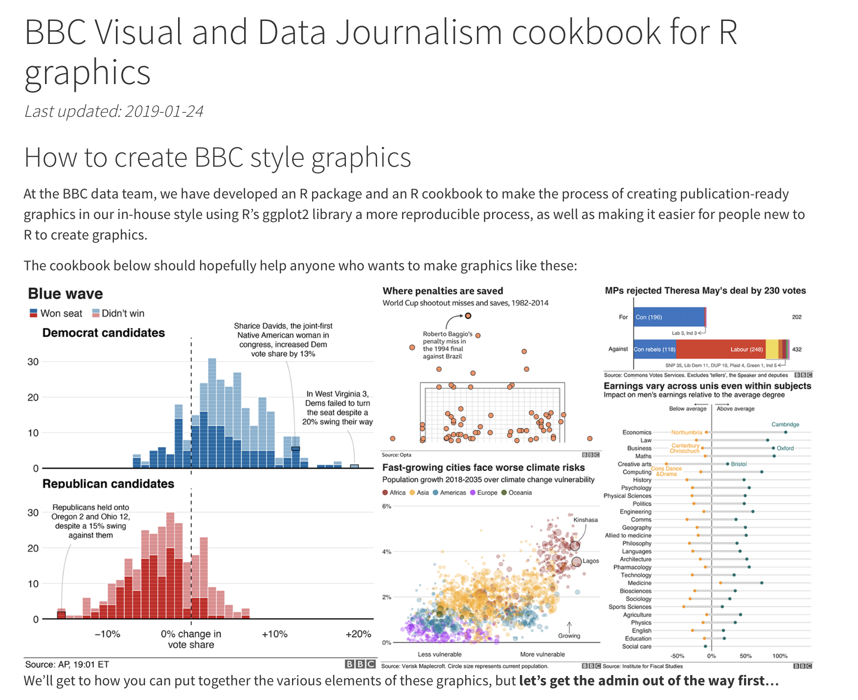
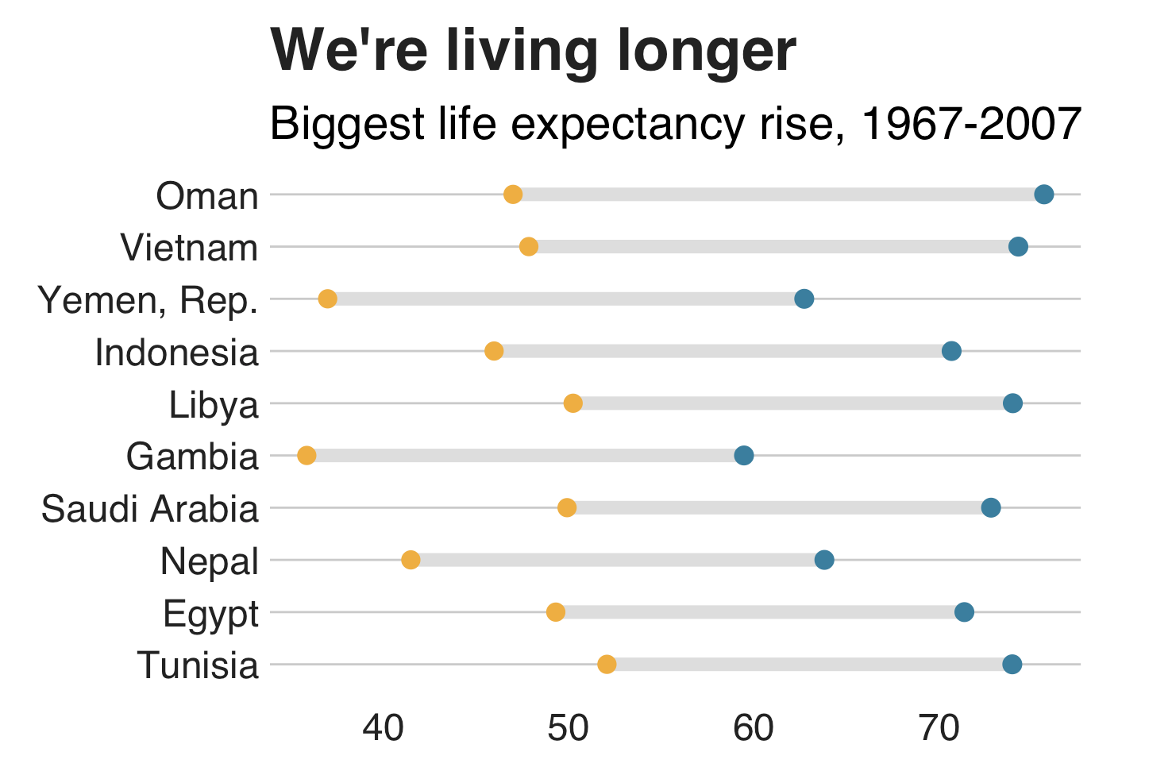
https://bbc.github.io/rcookbook/

Slide 38
Useful geoms
Geom | Purpose
geom_smooth() | Fits a smoother to data and displays the smooth and its standard error
geom_boxplot() | Produces a box-and-whisker plot to summarise the distribution of a set of points
geom_histogram() geom_freqpoly() | Shows the distribution of continuous variables
geom_bar() | Shows the distribution of categorical variables
geom_path() geom_line() | Draws lines between data points
geom_area() | Draws an area plot, which is a line plot filled to the y-axis. Multiple groups will be stacked upon each other
geom_rect() geom_tile() geom_raster() | Draw rectangles
geom_polygon() | Draws polygons, which are filled paths.

Slide 39
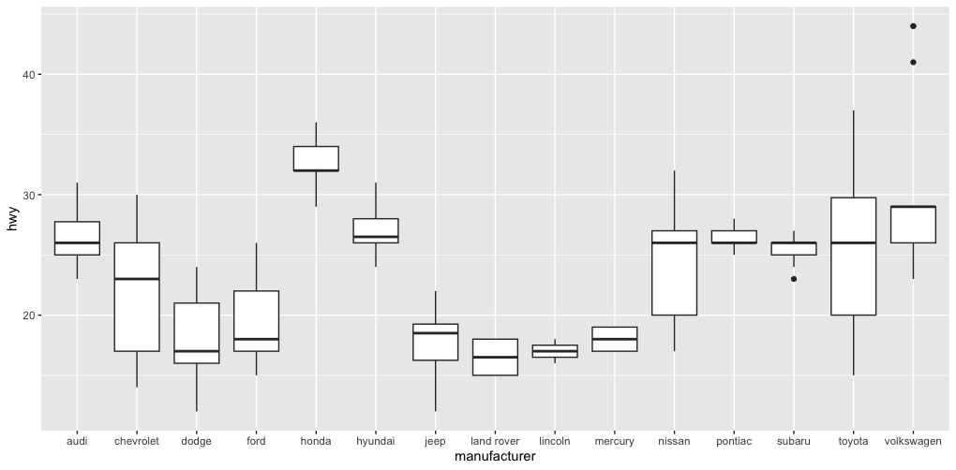
Challenge 3.2
Generate the following box plot (hwy by manufacturer) from mpg.

Slide 40
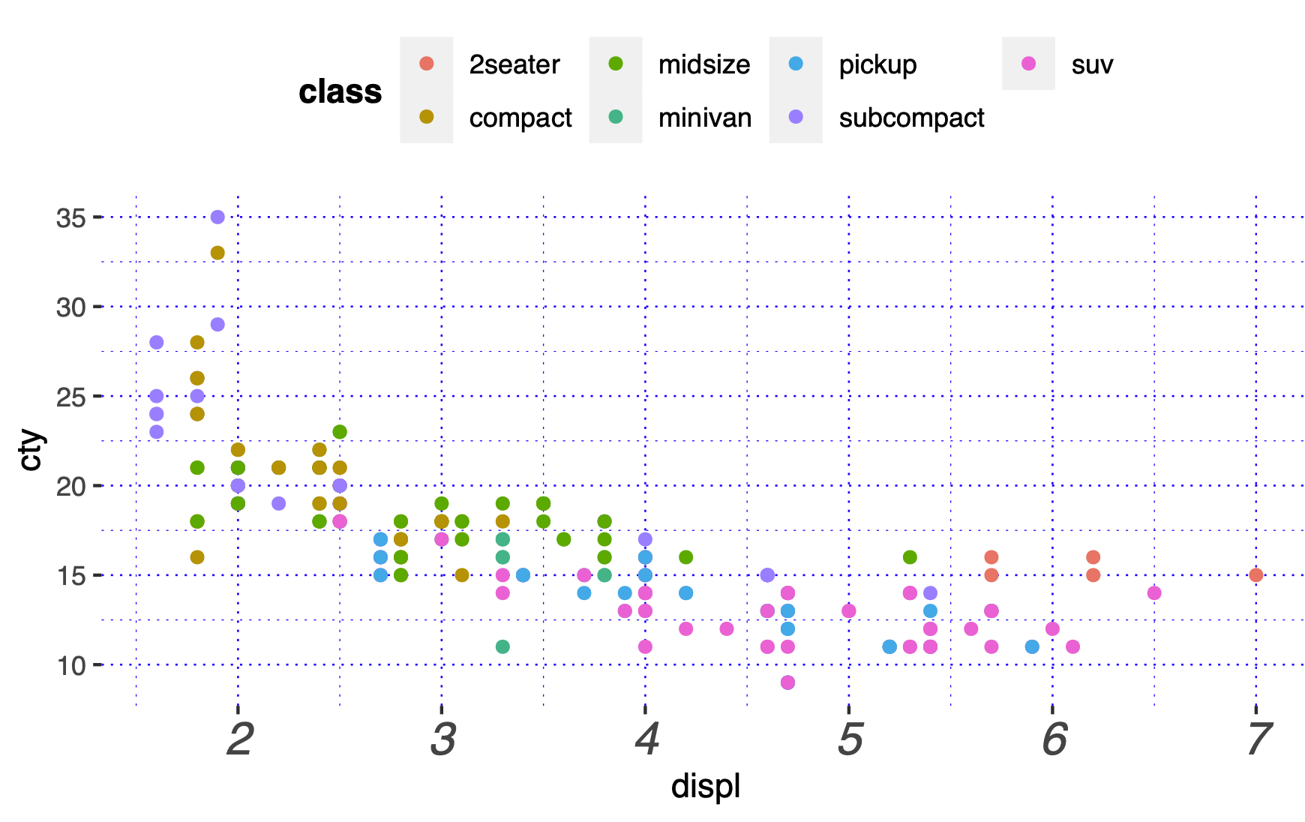
Summary
Layered grammar of graphics, enables us to concisely describe the components of a graphic.
Benefits:
plots can be designed in a layered manner (+ operator)
a wide range of plots can be generated to support decision analysis, including scatterplots, histograms and time series charts
charts can be developed rapidly, and this support an iterative process of decision support

Slide 41
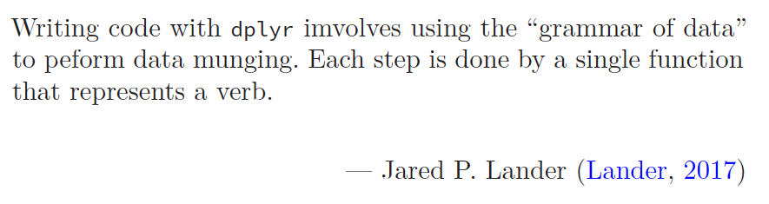
04 – Data manipulation with dplyr
https://github.com/JimDuggan/Exploring-OR-with-R-Workshop

Slide 42
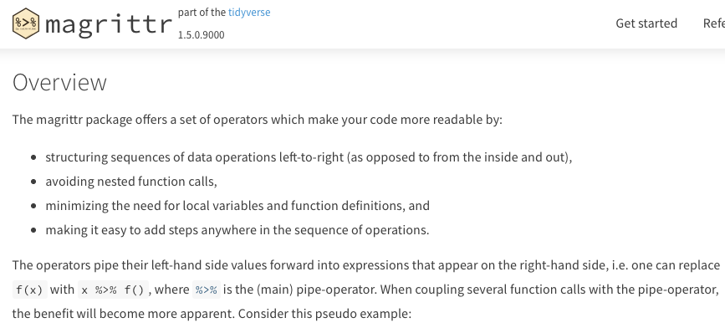
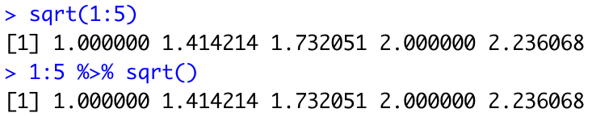
Combining operations with the Pipe
The pipe %>% comes from the magrittr package (Stefan Milton Bache)
Helps to write code that is easier to read and understand
x %>% f(y) turns into f(x, y)
x %>% f(y) %>% g(z) turns into g(f(x, y),z)
https://magrittr.tidyverse.org

Slide 43
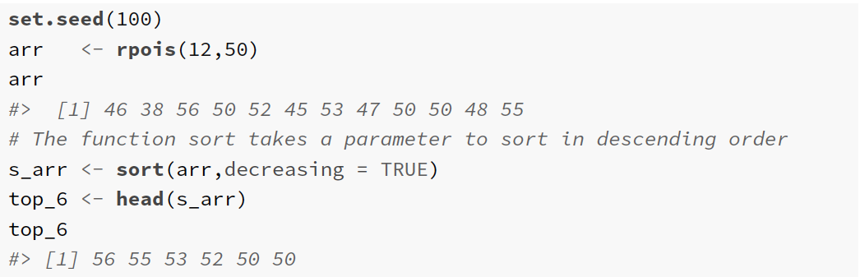
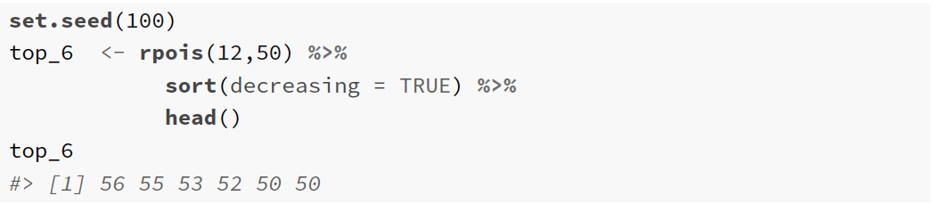

Slide 44
Utility of dplyr
Visualisation is an important tool for insight generation, but it’s rare that you get the data in exactly the right form you need (Wickham and Grolemund 2017)
Create new variables
Create summaries
Order data
dplyr package is designed for data transformation

Slide 45
dplyr Basics: 5 key functions
Function | Purpose
filter() | Pick observations by their values
arrange() | Reorder the rows
select() | Pick variables by their names
mutate() | Create new variables with functions of existing variables
summarise() | Collapse many values down to a single summary
”A grammar of data manipulation”
All verbs (functions) work similarly
The first argument is a data frame/tibble
The subsequent arguments decide what to do with the data frame/tibble
The result (data frame/tibble) supports chaining of steps – NOTE the “pipe operator” which we will cover later.
https://dplyr.tidyverse.org

Slide 46
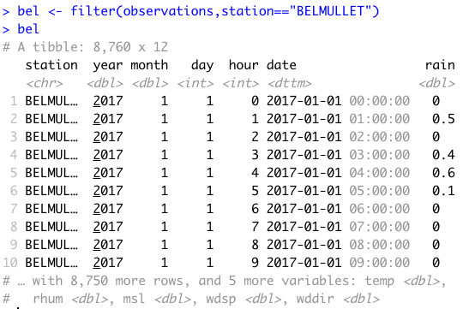
1. filter() aimsir17 tibble observations
First argument the name of the data frame
Subsequent arguments are expressions that filter the data frame
Subsequent arguments can be viewed as a succession of “and” statements
Number of columns does not change
Number of rows reduced (filtered)

Slide 47
Relational operators in R
Operators | Description
< | less than
<= | less than or equal to
> | greater than
>= | greater than or equal to
== | exactly equal to
!= | not equal to
!x | not x
x | y | x OR y
x & y | x AND y

Slide 48
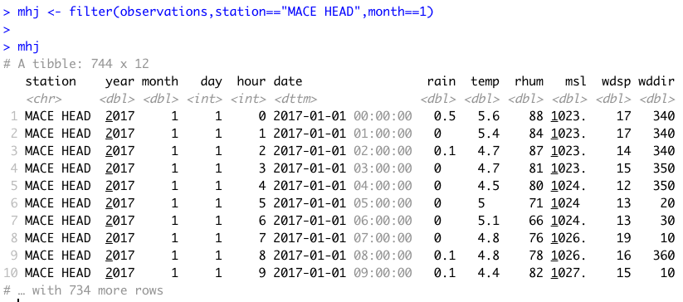
Show rows for “MACE HEAD” in January

Slide 49

Useful approaches for filtering more than one value
%in% operator in R

Slide 50
Challenge 4.1
Show the weather for “ROCHES POINT” on October 16th at 12 midday. This should return just one observation.

Slide 51

2. arrange()
Changes the order of rows.
Used for sorting values
Takes a tibble and a set of column names to order by

Slide 52

Mean Sea Level Pressure

Slide 53

More than one value

Slide 54

In descending order - desc()

Slide 55
Challenge 4.2
Arrange the observations by month and by highest temperature

Slide 56

3. select()
It is not uncommon to get datasets with hundreds, or even thousands, of variables
A challenge is to narrow down on the variables of you’re interested in
select() allows you to rapidly zoom in on a useful subset using operations based on the variable names
Number of rows does not change

Slide 57


Useful options with select()

Slide 58

Special functions with select()

Slide 59


Examples

Slide 60

everything()

Slide 61
4. mutate()
It is often useful to add new columns that are functions of existing columns
mutate() always adds new columns at the end of your data set.
For example, convert the mph wind speed in observations to a new column, kph.
Use a simplified observations tibble with day, month, station, wdsp as columns, and for “ROCHES POINT” on October 16th
Assume 1 mi = 1.609344 km

Slide 62


Example of mutate

Slide 63
Useful Creation Functions
There are many functions for creating new variables that can be used with mutate()
The key property is that the function must be vectorised:
It must take a vector of values as input, and,
Return a vector with the same number of values as output

Slide 64
Challenge 4.3
Add a new column rain_in, which measures the hourly rainfall in inches
Assume a conversion constant of 1 mm = 0.0393701 inches

Slide 65
5. summarise()
The last key verb is summarise()
It collapses a data frame into a single row
Not very useful unless paired with group_by() (it will just perform a summary of the whole data set)
Very useful to combine with the pipe operator

Slide 66

group_by()
Most data operations are useful done on groups defined by variables in the the dataset.
The group_by function takes an existing tbl and converts it into a grouped tbl where operations are performed "by group”.

Slide 67

Key idea
This grouping can then be exploited by summarise

Slide 68
Overall idea…
Original data frame
Grouped data frame
group_by()
summarise()

Slide 69
Useful Summary Functions
Grouping | Examples
Measures of location | mean(), median()
Measures of spread | sd(), IQR(),mad()
Measures of rank | min((), quantile(), max()
Measures of position | first(), nth(), last()
Counts | n(), n_distinct()
Counts and proportions of logical values | sum(x>0) when used with numeric functions, (T,F) converted to (1,0)

Slide 70
Challenge 4.4
For “BELMULLET” calculate the total daily rainfall for October, and show using ggplot.

Slide 71
dplyr Summary: 5 key functions
Function | Purpose
filter() | Pick observations by their values
arrange() | Reorder the rows
select() | Pick variables by their names
mutate() | Create new variables with functions of existing variables
summarise() | Collapse many values down to a single summary
”A grammar of data manipulation”
All verbs (functions) work similarly
The first argument is a data frame/tibble
The subsequent arguments decide what to do with the data frame/tibble
The result (data frame/tibble) supports chaining of steps – NOTE the “pipe operator” which we will cover later.
https://dplyr.tidyverse.org

Slide 72
Exploring Operations Research with R: A Workshop
05 – Operations Research Examples
https://github.com/JimDuggan/Exploring-OR-with-R-Workshop

Slide 73
Topics Overview
Topic | Description | ~Timing
1 | Introduction to R and Posit Cloud | 10 mins
2 | Storing data using data frames / tibbles | 10 mins
3 | Visualisation with ggplot2 | 20 mins
4 | Data transformation with dplyr | 20 mins
5 | Using R with OR – Four Examples | 30 mins
Example | Description
1 | Exploratory Data Analysis
2 | Linear Programming
3 | Agent Based Simulation
4 | Data transformation with dplyr

Slide 74
(1) Exploratory Data Analysis
“Exploratory analysis is what you do to understand the data and figure out what might be noteworthy or interesting to highlight to others. When we do exploratory analysis, it’s like hunting for pearls in oysters.”
Cole Nussbaumer Knaflic (Knaflic, 2015)

Slide 75

EDA Code Examples
Iris Flowers
Titanic
Victoria Electricity
Boston Housing
Irish Weather

Slide 76


(1) Iris Data Set

Slide 77


(2) Electricity Demand (Victoria)

Slide 78

(3) Boston Data

Slide 79

(4) Titanic Survival Data

Slide 80

(5) Irish Weather Analysis (Winter)

Slide 81

(2) Linear Programming
“The success of an OR technique is ultimately measured by the spread of its use as a decision making tool. Ever since in introduction in the late 1940s, linear programming (LP) has proven to be one of the most effective operations research tools.”
Hamdy A. Taha (Taha, 1992)

Slide 82


The Reddy Mikks example (Taha 1995)

Slide 83




Slide 84


Slide 85


Slide 86


Slide 87


Slide 88

(3) Agent Based Simulation
Situate an initial population of autonomous heterogeneous agents in a relevant spatial environment; allow them to interact according to simple local rules, and thereby generate – or “grow” - the macroscopic regularity from the bottom up.
Joshua M. Epstein (Epstein, 2012)

Slide 89



Slide 90


A single run…

Slide 91

Three Scenarios (Different seeded individual)

Slide 92

Quantile analysis

Slide 93

(4) System Dynamics
“Everything we do as individuals, as an industry, or as a society is done in the context of an information-feedback system.”
Jay W. Forrester (Forrester, 1961)

Slide 94

Limits to Growth Model

Slide 95

deSolve

Slide 96


Slide 97




Slide 98



Slide 99
SIRH Model

Slide 100


Slide 101



Slide 102


Slide 103

Exploring scenarios: 2 policy levers

Slide 104

Speed of vaccination
No vaccination,
no change in mobility = Max point
Speed of mobility reduction

Slide 105

Recap…
R programming language can be a valuable tool – and way of thinking – which can be successfully applied to the field of operations research (OR).
Core R tools (tidyverse)
Application areas to OR:
Exploratory Data Analysis
Linear Programming
Agent-Based Simulation
System Dynamics

